Slide 1
Regression and SVM

Slide 2
Agenda
Linear Regression
Polynomial Regression
Regularization (Ridge, LASSO and Elastic Net)
Logistic Regression
Softmax Regression
Support Vector Machine
Classification
Regression
Gradient Descent
Loss Functions

Slide 3
Linear Regression
Effective and Powerful
Use as baseline

Slide 4
Polynomial Regression

Slide 5
Ridge/L2 Regularization
Regularization is sensitive to scaling
Make sure to scale the data before applying
L2

Slide 6
Lasso/L1 Regularization

Slide 7
Elastic Net (L1 + L2)
r: L1 ratio

Slide 8
Early Stopping
Stop training as soon validation error hits a target
Simple and effective
Commonly used in DL

Slide 9
Logistic Regression
The hyperparameter controlling the regularization strength of a Scikit-Learn LogisticRegression model is not alpha (as in other linear models), but its inverse: C.
The higher the value of C, the less the model is regularized.

Slide 10
Softmax/Multinomial Regression

Slide 11
SVM: Classifier
SVM classifier as fitting the widest possible street (represented by the parallel dashed lines) between the classes.
This is called large margin classification.
Only need consider support vectors for training
find a good balance between keeping the street as large as possible and limiting the margin violations (i.e., instances that end up in the middle of the street or even on the wrong side)
Support Vectors: points on the edges

Slide 12
SVM in Scikit Learn
C is the hyperparameter
The higher the more overfitting

Slide 13
Kernel Trick
Kernel: Mapping data into higher dimensional space makes classification easier
Trick: mathematical properties that makes computation easier
Popular ones:
Gaussian
Poly
The hyperparameter coef0 controls how much the model is influenced by high-degree polynomials versus low-degree polynomial

Slide 14
SVR: SVM Regression
SVM: move as many data off the street as possible
SVR: include as many data on the street as possible

Slide 15
Gradient Descent

Slide 16
Batch Gradient Descent (BGD)
Involves calculations over the full training set X, at each Gradient Descent step
Slow on very large training sets
Scales well with the number of features
Learning Rate

Slide 17
Stochastic Gradient Descent (SGD)
SGD picks a random instance in the training set at every step and computes the gradients based only on that single instance
Convergence is much more irregular than BGD
When cost function is very irregular, SGD can help the algorithm jump out of local minima

Slide 18
Mini-Batch Gradient Descent (MBGD)
MBGD computes the gradients on small random sets of instances called mini-batches

Slide 19
Regression Loss Function
MSE/Quadratic/L2 Loss
Mean Absolute Error (MAE) /L1 Loss
Mean Bias Error

Slide 20
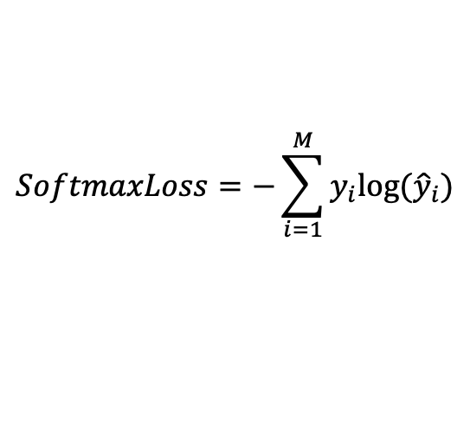
Classification Loss Functions
Hinge Loss
the score of correct category should be greater than sum of scores of all incorrect categories by some safety margin (usually one)
Cross Entropy/(Multinomial) Log(istic)/ Loss/Negative Log Likelihood
Most common setting for classification problems.
Cross-entropy loss increases as the predicted probability diverges from the actual label.
Categorical Cross-Entropy/Softmax Loss
$$SoftmaxLoss=−\sum_{i=1}^{M}{y_{i}log⁡({\hat{y}}_{i})}$$

Slide 21
Further Reading
https://ml-cheatsheet.readthedocs.io/en/latest/loss_functions.html#
https://www.analyticsvidhya.com/blog/2019/08/detailed-guide-7-loss-functions-machine-learning-python-code/
https://towardsdatascience.com/understanding-binary-cross-entropy-log-loss-a-visual-explanation-a3ac6025181a

